Slide 1
Cloud Computing and Software Development
Leah Riungu-Kalliosaari

Slide 2
Contents
Cloud computing
  Definition, characteristics, service models, deployment models
  Benefits and disadvantages
Cloud computing players
Developing software using the cloud
  Major cloud computing vendors
  Google app engine
  Amazon web services
  Implications
  Challenges

Slide 3
Definition
Many definitions exist
Cloud computing is the delivery of computing as a service rather than a product, whereby shared resources, software, and information are provided to computers and other devices as a utility (like the electricity grid) over a network (typically the Internet) - Wikipedia

Slide 4
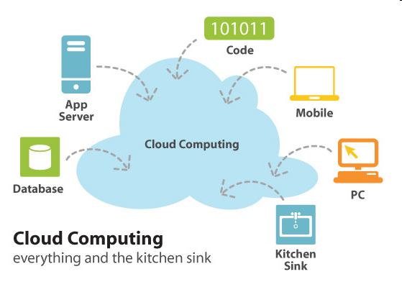

Slide 5
Definition
Cloud computing is a model for enabling ubiquitous, convenient, on-demand network access to a shared pool of configurable computing resources (e.g., networks, servers, storage, applications, and services) that can be rapidly provisioned and released with minimal management effort or service provider interaction.
  This cloud model is composed of five essential characteristics, three service models, and four deployment models.
Source: The NIST definition of Cloud Computing, http://csrc.nist.gov/publications/nistpubs/800-145/SP800-145.pdf

Slide 6
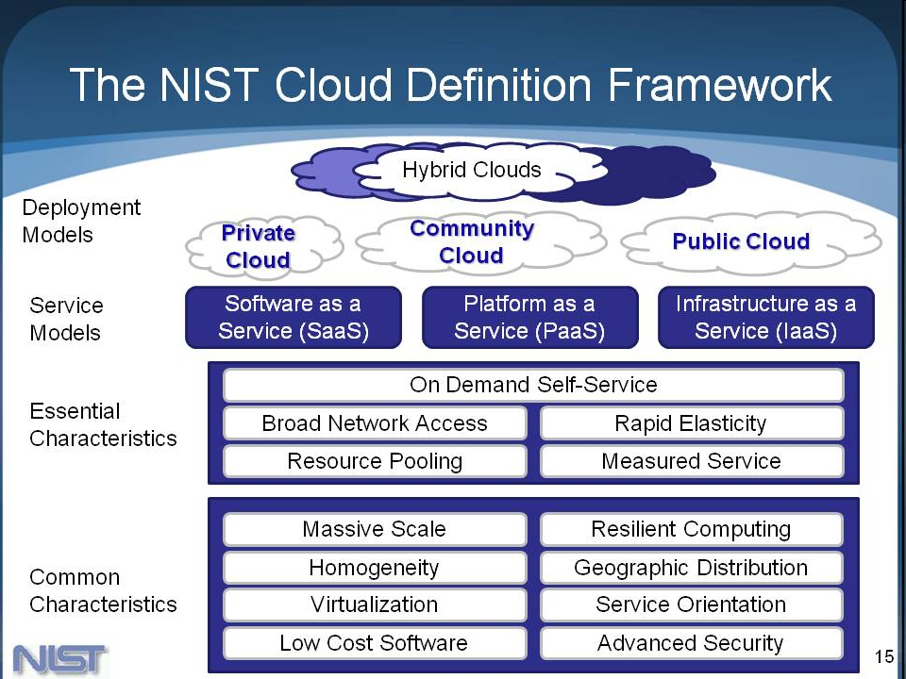

Slide 7
Characteristics
Source: NIST
On-demand self-service
  A consumer can unilaterally provision computing capabilities, such as server time and network storage, as needed automatically without requiring human interaction with each service provider.
Broad network access.
  Capabilities are available over the network and accessed through standard mechanisms that promote use by heterogeneous thin or thick client platforms (e.g., mobile phones, tablets, laptops, and workstations).
Resource pooling.
  The provider’s computing resources are pooled to serve multiple consumers using a multi-tenant model, with different physical and virtual resources dynamically assigned and reassigned according to consumer demand. There is a sense of location independence in that the customer generally has no control or knowledge over the exact location of the provided resources but may be able to specify location at a higher level of abstraction (e.g., country, state, or datacenter). Examples of resources include storage, processing, memory, and network bandwidth.

Slide 8
Characteristics
Rapid elasticity
  Capabilities can be elastically provisioned and released, in some cases automatically, to scale rapidly outward and inward commensurate with demand. To the consumer, the capabilities available for provisioning often appear to be unlimited and can be appropriated in any quantity at any time.
Measured service.
  Cloud systems automatically control and optimize resource use by leveraging a metering capability at some level of abstraction appropriate to the type of service (e.g., storage, processing, bandwidth, and active user accounts). Resource usage can be monitored, controlled, and reported, providing transparency for both the provider and consumer of the utilized service.
Source: NIST

Slide 9
Service Models
Software as a Service
The capability provided to the end user is to use the provider’s applications running on a cloud infrastructure.
  Applications
    User interface
    Frontend applications e.g. Google docs, hotmail
  Application services
    Web service interface
    Basic or composite e.g Google maps
The end user does not manage or control the underlying cloud infrastructure including network, servers, operating systems, storage, or even individual application capabilities.
The end user might have control over limited user-specific application configuration settings.
The end user does not care where the application is hosted, or what is the undelying operating system.
Source: NIST

Slide 10
Service Models
Platform as a Service
The capability provided to the end user is to deploy onto the cloud infrastructure consumer-created or acquired applications created using programming languages, libraries, services, and tools supported by the provider.
  Programming environment
    Programming language, libraries
  Execution environment
    Runtime environment
    E.g. Google App Engine
The end user does not manage or control the underlying cloud infrastructure including network, servers, operating systems, or storage.
The end user has control over the deployed applications and possibly configuration settings for the application-hosting environment.
Source: NIST

Slide 11
Service Models
Infrastructure as a Service
The capability provided to the end user is to provision processing, storage, networks, and other fundamental computing resources where the consumer is able to deploy and run arbitrary software, which can include operating systems and applications.
  Infrastructure services
    Storage
    Computational
    Databases
    Network
    E.g. Google bigtable
The end user does not manage or control the underlying cloud infrastructure.
The end user has control over operating systems, storage, and deployed applications; and possibly limited control of selected networking components (e.g., host firewalls).
Source: NIST

Slide 12
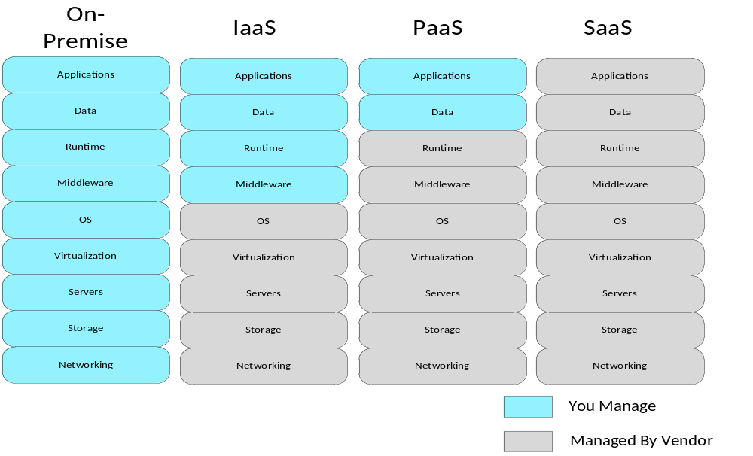
Management responsibilities of Cloud Service Types
Source: Chou, D., 2010 Microsoft Cloud Computing Platform

Slide 13
Service Models
Human as a Service
  Crowdsourcing
    Enabling collective intelligence e.g. Mechanical Turk
    Crowdsourced testing services e.g. uTest
  Information markets
    Information aggregation services
    Prediction of events e.g. Iowa Electronic Markets
Source: A. Lenk, M. Klems, J. Nimis, S. Tai, T. Sandholm, “What’s in the cloud: An architectural map of the cloud landscape,” In Proc. Cloud computing workshop, International Conference on Software Engineering, 2009

Slide 14
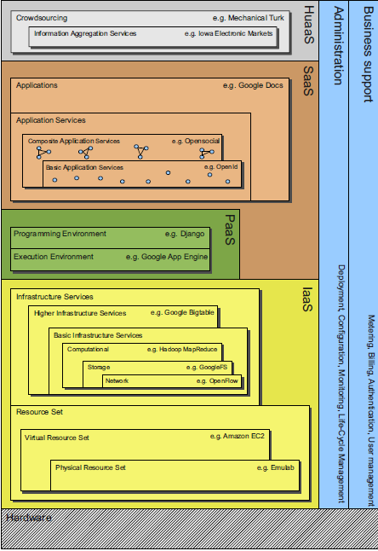
Source: A. Lenk, M. Klems, J. Nimis, S. Tai, T. Sandholm, “What’s in the cloud: An architectural map of the cloud landscape,” In Proc. Cloud computing workshop, International Conference on Software Engineering, 2009

Slide 15
Deployment Models
Private cloud
  Cloud infrastructure specifically used by users within a single organization
  May be owned, managed, and operated by the organization, a third party, or some combination of them.
  May exist on or off premises.
Community cloud.
  Cloud infrastructure used by a specific community of end users from organizations with shared concerns (e.g., mission, security requirements, policy, and compliance considerations).
  May be owned, managed, and operated by one or more of the organizations in the community, a third party, or some combination of them
  May exist on or off premises.
Source: NIST

Slide 16
Deployment Models
Public cloud.
  Cloud infrastructure used open for use by the general public.
  May be owned, managed, and operated by a business, academic, or government organization, or some combination of them.
  It exists on the premises of the cloud provider.
Hybrid cloud.
  The cloud infrastructure used by two or more distinct cloud infrastructures (private, community, or public) that remain unique entities, but are bound together by standardized or proprietary technology that enables data and application portability (e.g., cloud bursting for load balancing between clouds).
Source: NIST

Slide 17
Benefits
Reduced capital expenditure and maintenance costs
  IT resources are hosted in the cloud hence reduced need for specialized hardware
Infinite scalability
Access to global markets
Quick time to market
Business competitiveness
  Startups can compete with established corporations

Slide 18
Disadvantages
Security, privacy and data integrity
  Where is the data stored, who has access to the data, who is responsible if security is compromised, or information is lost
Lack of control
  How does the business retain and maintain lack of control
Availability
  How does the occurrence of downtime affect the business

Slide 19
Cloud Players
Cloud infrastructure service providers – raw cloud resources; IaaS
Cloud platform service providers – resources + frameworks; PaaS
Cloud intermediaries – help broker some aspect of raw resources and frameworks e.g. service management, load balancing etc
Cloud application service providers – software applications; SaaS
Cloud consumers – users of all the above

Slide 20
Different from Web Services
Resource pooling: Cloud computing providers harness large economies of scale through resources pooling. They put together a vast network of servers and hard drives and apply the same set of configurations, protection and the works for them.
Virtualization: Users do not have to care about the physical states of their hardware nor worry about hardware compatibility.
Elasticity: Addition of more hard disk space or server bandwidth can be done with just a few clicks of the mouse on-demand. Geographical scalability is also available in cloud computing - one can choose to replicate data to several data centres around the world.
Automatic/easy resource deployment: The user only needs to choose the types and specifications of the resources he require and the cloud computing provider will configure and set them up automatically.
Metered billing: Users are charged for only what they use.

Slide 21
Developing Software using the Cloud

Slide 22
Cloud Computing Vendors
Google - Google App Engine
  Java, Python
Amazon web services - Elastic Compute Cloud (EC2)
  C#, .NET
Microsoft - Windows Azure Platform
  .Net languages, C++, Java
Salesforce (Force.com)
  Apex, Visualforce
Many others e.g. Rackspace, VMware, Skytap, Heroku

Slide 23
Cloud-based Software Development
Using the cloud to develop software
  Cloud-based software i.e. SaaS
  Non SaaS eg desktop applications
Developers have access to platforms to build and host their applications
The applications run in data centers that are managed by the platform provider

Slide 24
Cloud-based Software Development
Fast development
  From idea to market ready product within weeks
  Quick to market
Agile development methods are used
Views from a small cloud start up

Slide 25
Google App Engine
Provides detailed information about the usage of the system
  Dashboard: basically an administrative view
  Follow real time usage e.g. CPU hours in usage, data storage requests received etc
  Error logs

Slide 26
Google App Engine
Authentication system based on GAE user API
  Google handles user authentication
  Google stores the user info
  Google handles security e.g. in case of security breaches
TRUST is important
  Developer’s relationship with Google is based on trust
  Developer makes use of the APIs based on the provided documentation
    Dos and Donts
    By following the guidelines, it is hard for a developer to breach the security. May be unless hacking is the developer’s intention.

Slide 27
Amazon Web Services
Three options when using EC2
Ready built Amazon machine images for use at no additional cost
  Pre-installed Linux distributions e.g. Redhat, Fedora 8
  Windows servers
Community made public Amazon machine images
  If used, the developer needs to trust the person or organization that created the machine image
  It takes a lot of time going through all the details of capabilities of the responsible server
Build your own amazon machine eg a Linux server, deploy it as a virtual image to Amazon and use it as you like
  You can publish it for others to use

Slide 28
Amazon Web Services
Responsible for the physical security
  Developer can know where the data is stored, the virtualization stack, the software used to handle to data
  No information about the internal operations of the data center
Developer is responsible for some aspects of security
  Similar to managing traditional servers e.g. which ports are open or closed
In terms of security, it is easy for a developer to compromise security
  E.g. using a public Amazon machine image created by another developer

Slide 29
Cloud-based Software Development: Implications
Code base must work within the limitations of the platform e.g. with GAP, you can fetch 1000 lines at a time, there is a specified duration for how long your script can run before it is terminated
Some open source platforms are available for use, e.g. AppScale is a copy of GAP.
  Install AppScale on your local server and use it to run your scripts
  You must be aware of the limitations once you port your code to the ”real” cloud environment

Slide 30
Cloud-based Software Development: Implications
Code quality may not be optimal
  Code quality vs economics
  For example, if an application is set to respond within 100 milliseconds, and the code is not optimal, the platform will use more servers to meet the limit.
Code sharing and collaborative development is likely to grow e.g supported by Github
  Especially useful when it does not matter where one is located around the globe

Slide 31
Cloud-based Software Development: Implications
Physical infrastructure and bandwidth are availed by the cloud provider, the developer only needs to use and pay
Pay-as-you-go pricing could result in unplanned expenditure e.g. if have a bug in your code and you enter an eternal loop
Scaling abilities are in-built within the platform
  Instructions are provided on how to enable automated scaling
  Performance testing is likely to become critical in the future
  Code optimization helps to prevent using too many resources (server instances) especially when the application needs to scale.

Slide 32
Cloud-based Software Development: Implications
Reduced need for capital investments
  The required resources are available for use
  Only one’s skills, time and a little bit of money is needed
  Operational costs incurred as one uses the platform
Encourage innovativeness
  Little costs are incurred to develop an idea, not much to loose if it does not thrive in the market

Slide 33
Cloud-based Software Development: Implications
There is a level of tolerance towards errors by some cloud users
  They do not expect the systems to be perfect, as long as they work
  They know the bugs will be fixed soon
  E.g. as of November 2011, Google Apps sites would freeze when run using internet explorer version 8

Slide 34
Cloud-based Software Development: Implications
There is wide variety of potential users, so expect to run into errors even after releasing the product/service
Security remains important
  Data encryption can be used, and the performance implications (of data encryption) need to be understood

Slide 35

Challenge: Security

Slide 36
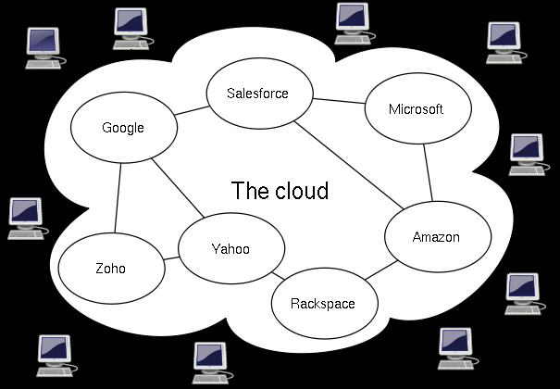
Challenge: Interoperability

Slide 37

Challenge: Vendor lock-in

